Slide 1
Prime Time
NOTES, VIDEOS, & GAMES
View in PRESENT MODE
Click here to go to Table of Contents

Slide 2
Table of Contents
Divisibility Rules
Factors & Multiples
Factors, Multiples, GCF & LCM:Online Game
Least Common Multiples: Online Game:
Greatest Common Factor & Least Common Multiple
Order of Operations
Order of Operations Millionaire: Online Game
Order of Operations Heist: Online Game:
Prime Factorization
Prime & Composite Numbers
Prime Factorization: Online Game:
Prime Factorization #2: Online Game:
Prime Factorization: Video
Prime Factorization to find GCF & LCM
Square Numbers
The Distributive Property
The Distributive Property (Friendship Bracelets): Video
The Distributive Property (Math Antics): Video

Slide 3
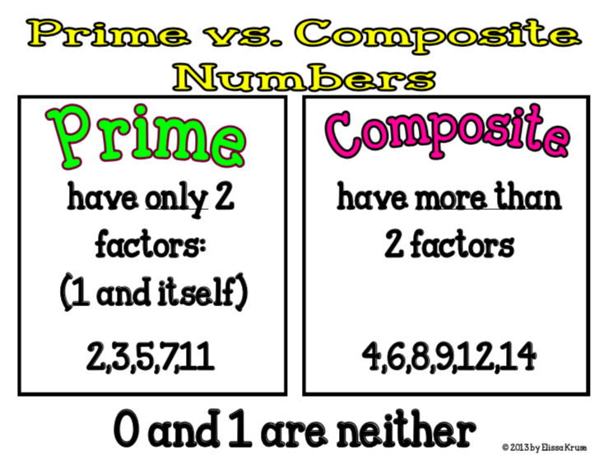
Click here to go back to Table of Contents

Slide 4
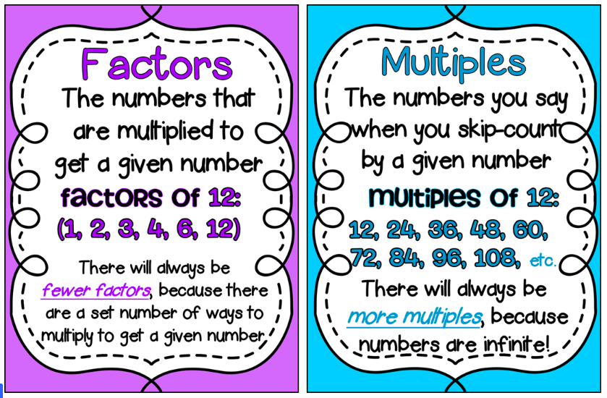
Click here to go back to Table of Contents

Slide 5
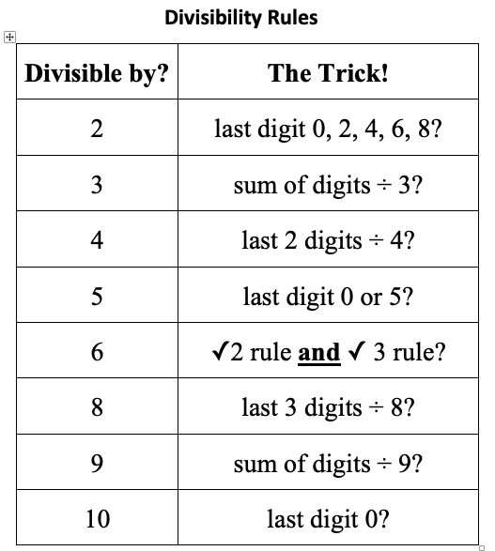
Click here to go back to Table of Contents

Slide 6
Greatest Common Factor
Least Common Multiple
Click here to go back to Table of Contents

Slide 7
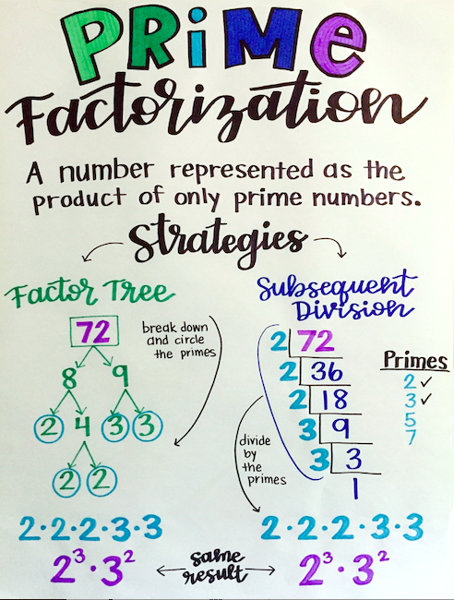
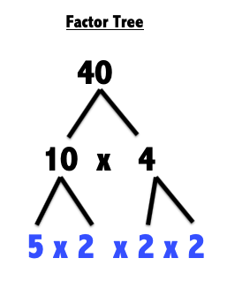
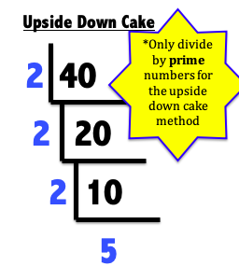
Use subsequent division to find the prime factorization of 40.
Use a factor tree to find the prime factorization of 40.
Click here to go back to Table of Contents

Slide 8
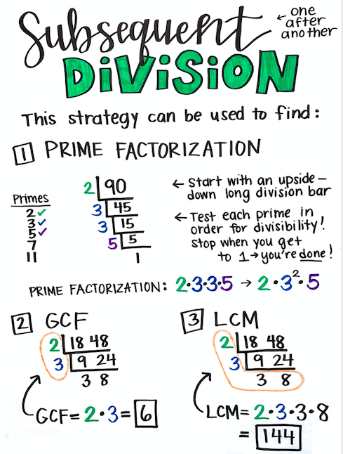
Prime Factorization
Find
Least Common Multiple
Find
Greatest Common Factor
Click here to go back to Table of Contents

Slide 9
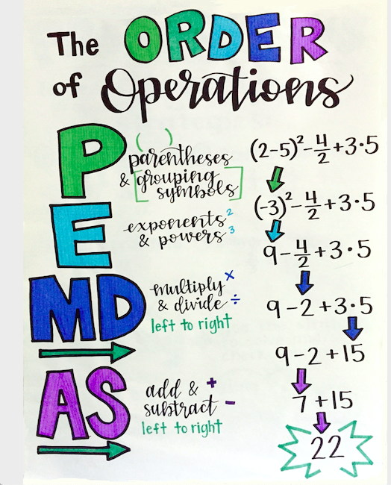
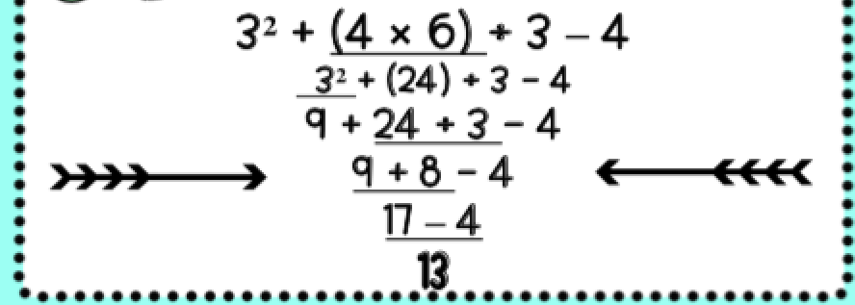
Try this problem! Click forward to uncover each step and the answer!
➗
➗
➗
Did you get it correct? If not, where did you go wrong?
Click here to go back to Table of Contents

Slide 10
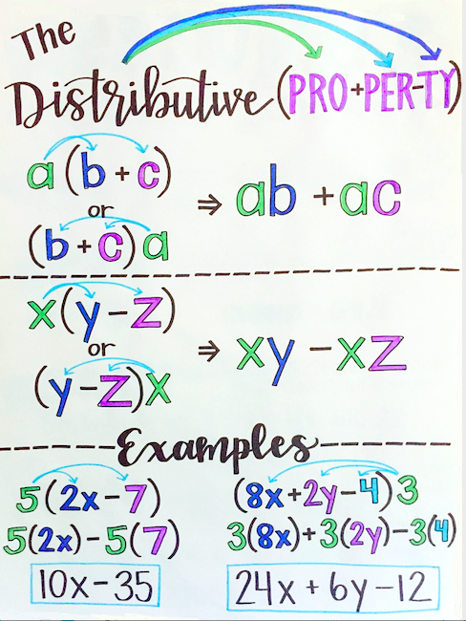
Click here to go back to Table of Contents

Slide 11
Click here to
Go Wild & memorize square numbers up to 15²!
Click for answer!
Click here to go back to Table of Contents

Slide 12
Click here to go back to Table of Contents

