Slide 1
Back to School Night
Tuesday, September 22, 2020
MRS. FRITZ
HEALTH & P.E.
7:00 - 7:30 https://meet.google.com/epm-oddf-eva

Slide 2
Mrs. Fritz
Email - kfritz@spfk12.org
School Phone Number
908 -223-5281 x 1641 Available by phone when hybrid learning begins.
Mrs. Fritz Teacher Page

Slide 3
A little about me.
Health, fitness and nutrition has alway been a passion of mine. In July of 2000 I took an adventure to Alaska to attend the National Outdoor Leadership School (NOLS) working to achieve a certification in outdoor education. From there I focused my goals on attaining yoga teacher certification (RYT 500). After teaching yoga for a few years I decided to head back to school for a teaching degree focused in Health and Physical Education. In September of 2008 I began my journey as a teacher at McGinn Elementary School.

Slide 4
Weekly Schedule
Health & Physical Education Schedule

Slide 5
Typical Class Outline
Mrs. Fritz Weekly Lesson Outline

Slide 6
Google Classroom
The Elementary Health & Physical Education Department offers a Google Classroom for each section we teach. We also host a Resource page for students to visit for extra and alternative activities.

Slide 7
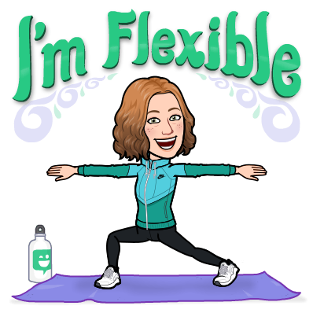
2:00 - 3:00
Afternoon Enrichment
This is a space where we will explore new ideas and activities.
Learning space, Masks, Pod limitations will all be considered when designing an activity so we can best serve all who attend.
2:00 - 2:30
2:30 - 3:00

Slide 8
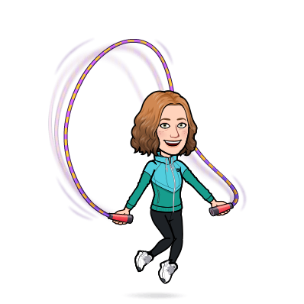
What Is PE?
Physical educations, also known as PE or Phys. Ed is a planned, sequential, standards-base program of curricula and instruction designed to develop motor skills, knowledge, and behaviors for active living, physical fitness, sportsmanship, self-efficacy and emotional intelligence.

Slide 9
Focuses In Elementary PE
Elementary Physical Education focuses on motor skills and coordination, and keeps activities short and engaging.
Promotes personal responsibility,
rules, and safety.
Uses collaboration and tandem exercises
to increase confidence

Slide 10
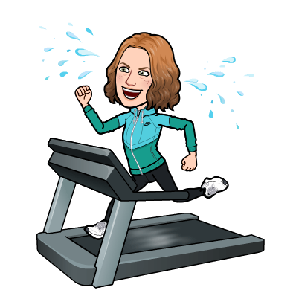
McGinn PE
In the gym and the virtual space at McGinn, I work to incorporate a variety of lessons taking into consideration not only state and national standards, but research in areas like “brain gym” and concepts from experiential learning practices. I also incorporate Project Adventure activities, sports and fitness lessons as well as social and emotional learning theories. But most importantly I work to engage students in FUN!

Slide 11
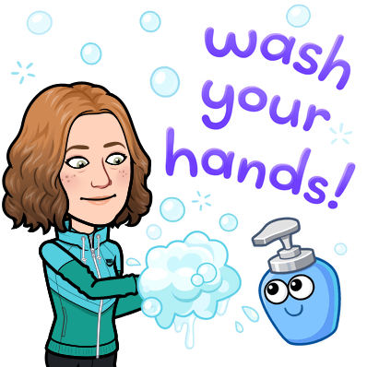
Health Lesson Focus
A variety of health lessons are integrated into classroom and physical education time.
These classes bring further focus to:
Tobacco
Alcohol
Nutrition
Wellness
Safety

Slide 12
Assessment
Marking Period 1:
Movement locomotor / Non locomotor skills
Marking Period 2:
Manipulative Skills
Marking Period 3:
Movement Education / Rhythm
Skill Grade: Number Grade 1-4
1. I did not do / could not do what should be done.
2. There is more that I can do.
3. I did what was asked of me.
4. I did all that was asked and more.
Participation Grade:
· Consistently
· Usually
· Sometimes
· Infrequently

Slide 13
Physical Education Events

