Slide 1
Decimal Ops
Notes, Videos & Games
View in PRESENT MODE

Slide 2
Table of Contents
Benchmark Decimals, Fractions, & Percents
Notes & Practice
Decimals -- All Operations
Notes page
Online Games
Online Decimal Jeopardy +-*
Song
Decimal Addition & Subtraction
Notes
Song
Video
Decimal Division
Notes
Song
Video 1
Video 2
Decimal Multiplication
Notes
Video -- Multiple Strategies
Video -- Standard Strategy
Percents
Video -- What Percent is it?
Video -- Finding Percent of a Number.
Traditional Long Division → Whole Numbers
Song
Video
Traditional Multiplication → Whole Numbers
Video

Slide 3
Click here to go back to Table of Contents

Slide 4
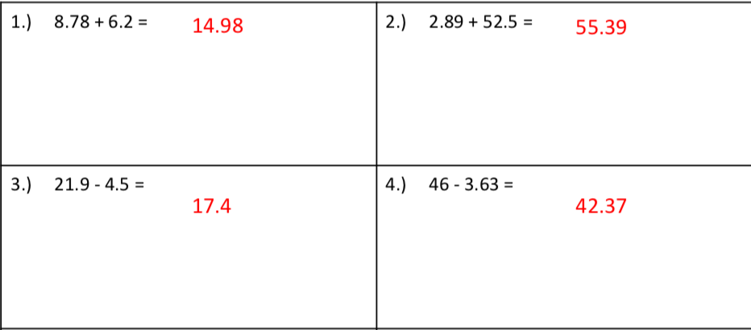
Decimal Addition/Subtraction Practice Problems
Solve each problem below and click to reveal answers!
Click here to go back to Table of Contents
Did you remember to LINE UP THE DECIMALS?

Slide 5
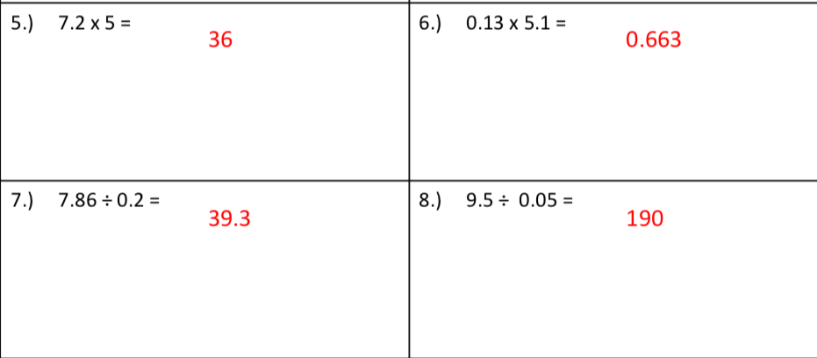
Decimal Multiplication/Division Practice Problems
Solve each problem below and click to reveal answers!
Click here to go back to Table of Contents
How did you do? Click here to review the rules for multiplication and division of decimals!

Slide 6
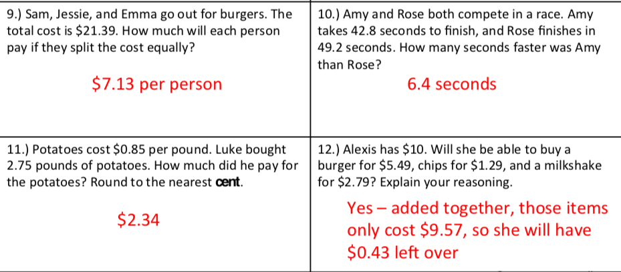
Practice Word problems! Solve each problem below and click to reveal answer!
21.39 ➗ 3 =
49.2 - 42.8=
0.85 x 2.75 =
Click here to go back to Table of Contents

Slide 7
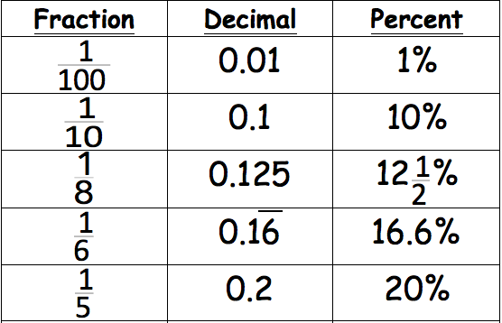
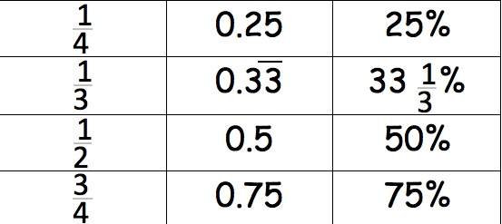
BENCHMARK FRACTIONS, DECIMALS, & PERCENTS
YOU SHOULD KNOW!
Test yourself! Click forward to the next two slides and see if you know the BENCHMARKS!
Click here to go back to Table of Contents

Slide 8
Time to Practice BENCHMARK FRACTIONS, DECIMALS, PERCENTS YOU SHOULD KNOW!
Once a fraction, decimal, or percent is revealed find the corresponding fraction, decimal or percent.
Click here to go back to Table of Contents

Slide 9
Time to Practice BENCHMARK FRACTIONS, DECIMALS, PERCENTS YOU SHOULD KNOW!
Click here to go back to Table of Contents

Slide 10
Click here to go back to Table of Contents

