Slide 1
Comparing
Bits & Pieces
Notes, Videos & Games
View in PRESENT MODE

Slide 2
Table of Contents
Absolute Value
Absolute Value → Video
Fractions → Comparing
Fractions → Comparing → Video
Fractions→ Equivalent Online Game
Fractions → Equivalent → Video
Fractions -- Improper/Mixed Numbers
Fractions → Improper/Mixed Numbers --> Video
Integers → Menu of Online Games
Integers → Ordering Online Game
Integers -- Positive & Negative Numbers
Integers → Video
Ratios
Ratio and Fraction Song
Ratios Blaster Online Game
Ratio Rumble Online Game
Ratios Song
Ratios → What’s The Ratio Song
Unit Rates
Unit Rates → Video
Percents
Percents → Video

Slide 3
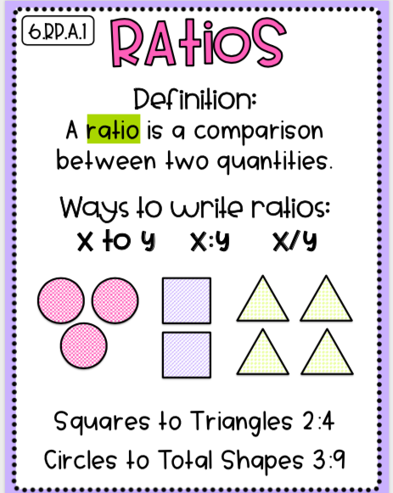
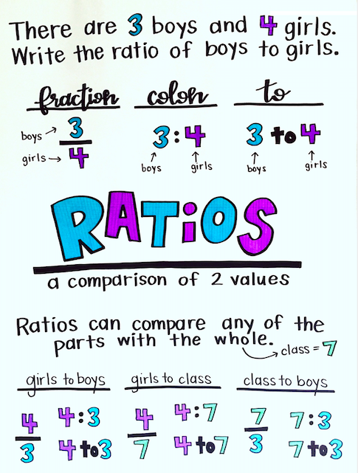
Click here to go back to Table of Contents

Slide 4
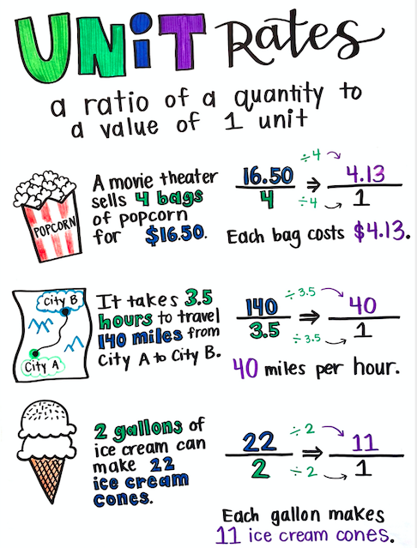
Click here to go back to Table of Contents

Slide 5
Click here to go back to Table of Contents

Slide 6
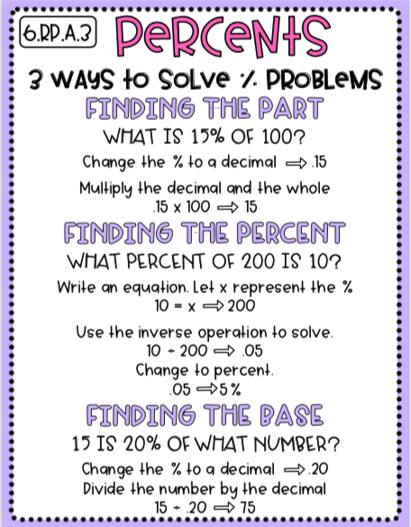
Click here to go back to Table of Contents

Slide 7
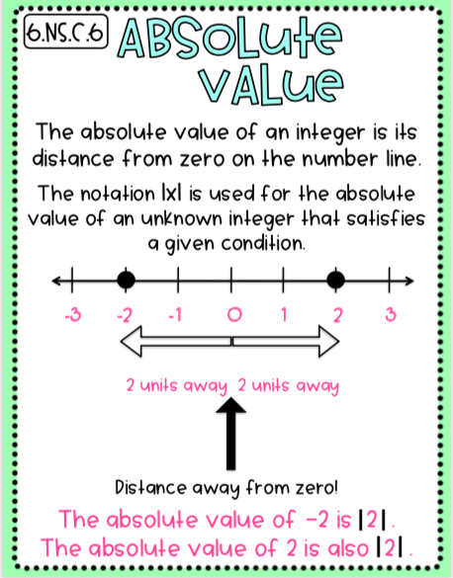
Click here to go back to Table of Contents

Slide 8
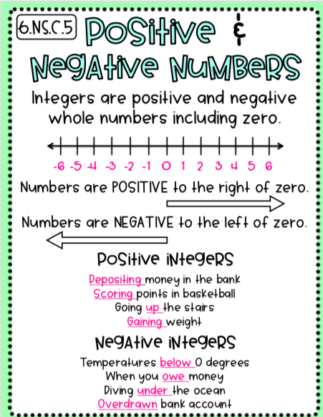
Click here to go back to Table of Contents

Slide 9
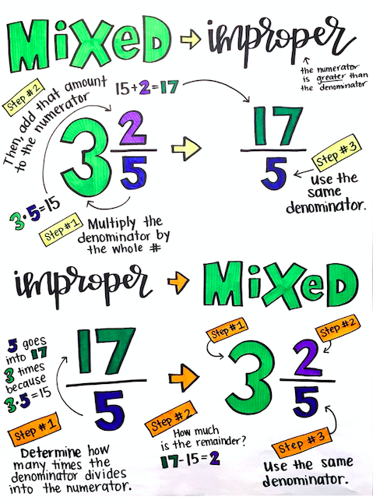
Click here to go back to Table of Contents

Slide 10
Click here to go back to Table of Contents

